Slide 1
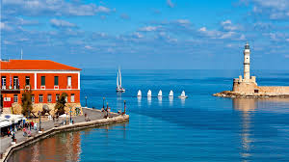
How to spend your summer time in Chania!!!
Chania is a coastal town of Crete and capital city of Chania prefecture. Placed in the Northwest of Crete, it offers an atmposphere of Venice combined with the cretan culture and character. Chania is surrounded by numerous options of sighthseeing, exploration and entertainment.
Venetian old Harbour
Notes:
1

Slide 2
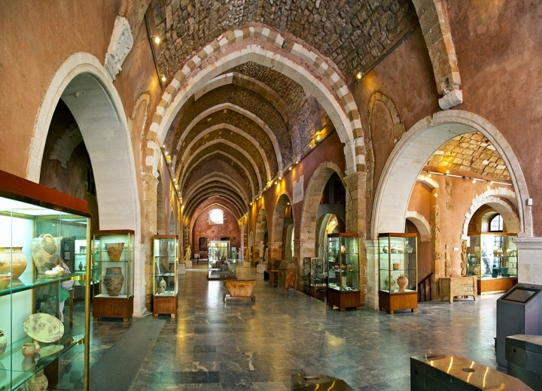
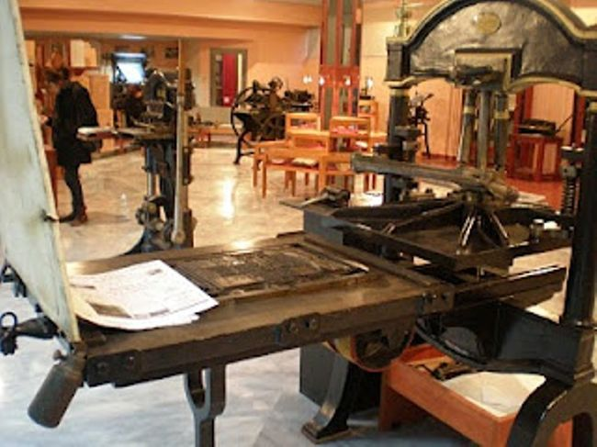
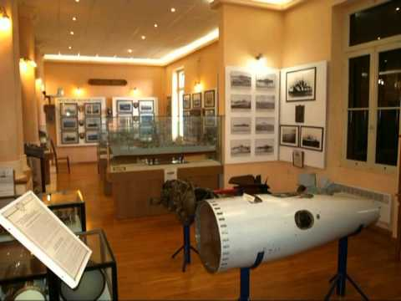
What to visit and see
Visit the archaeological museum placed at the Catholic Venetian monastery of Saint Francis in Halidon str.
Go to the Print Museum and admire a duplicate of Gutenberg first typing machine.
The Naval museum may surprise you in many ways. It combines both interesting naval exhibits and an astonishing view.

Slide 3
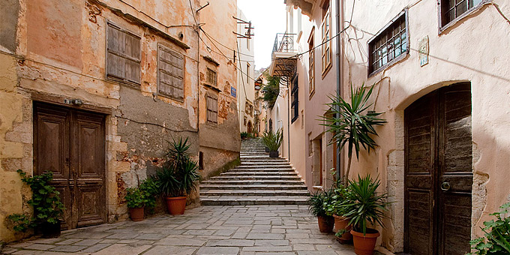
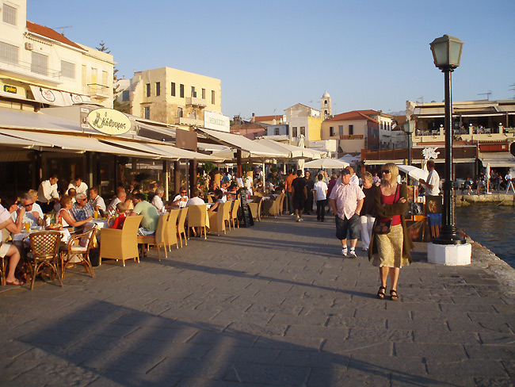
Take a walk at the city centre
Afterwards take a walk at the city's narrow alleys to enjoy the beautiful sight, smell the citrus trees and taste traditional greek food like souvlaki. You can also buy traditional products. You can also have either your breakfast or dinner at the seafront cafes while enjoying the sight of the lighthouse in the old harbour.

Slide 4
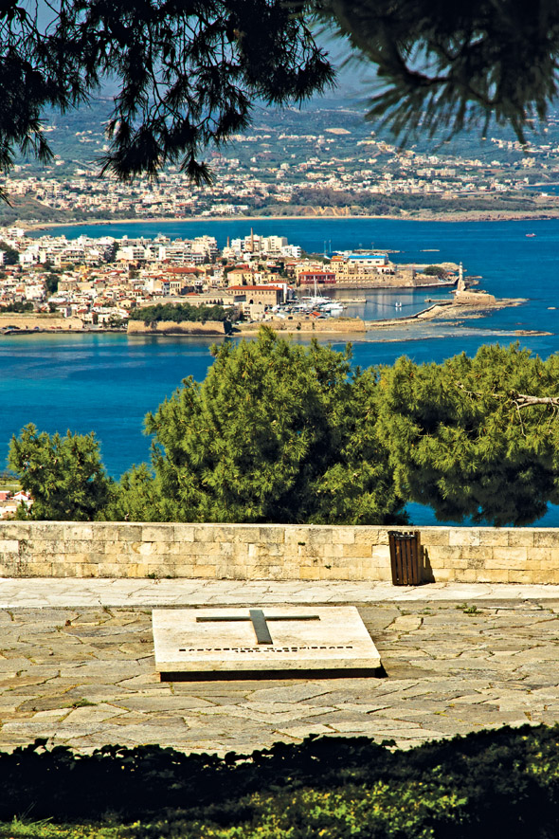
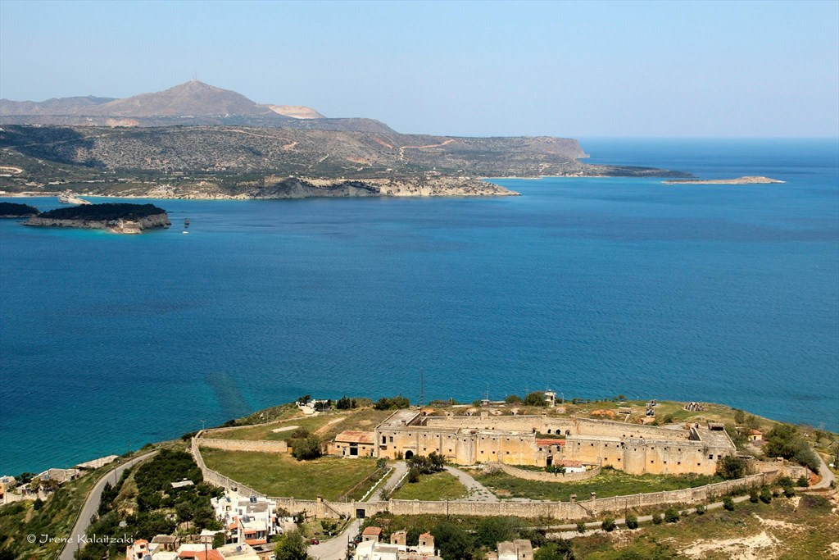
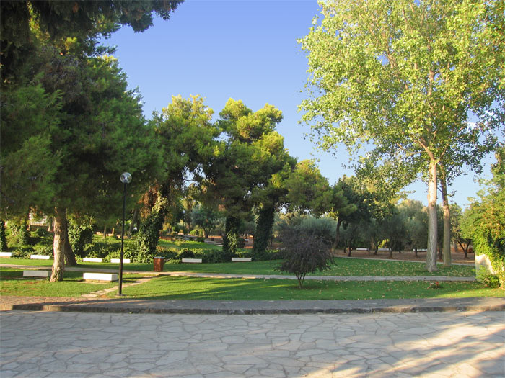
Enjoy the view
Venizelos tombs (the photo at the right and at the bottom left) is a place into a green park that offers a magical view of the town.
In Itzedin castle (bottom right) you can combine watching interesting performances while enjoying the magnificent sunset.

Slide 5
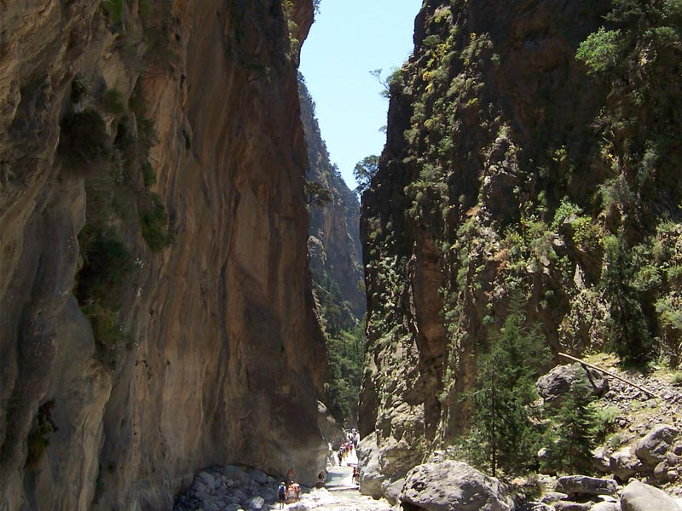
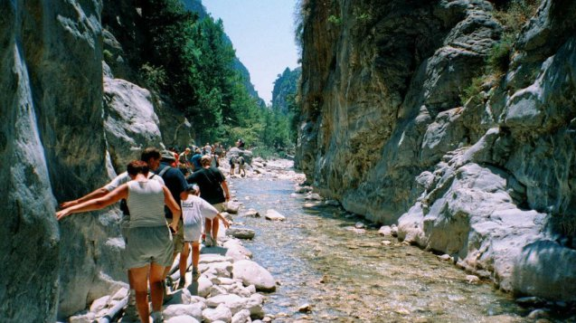
Explore the mountains
The famous gorge of Samaria lies on the southern side of Chania and it has been declared as a National park for the survival of the endangered species, the kri kri goat. It’s an ideal place for hikers. Many visitors do trekking on it. You will approximatelly need seven hours to end up at Loutro where you can find ferries to take you to Sfakia.

Slide 6
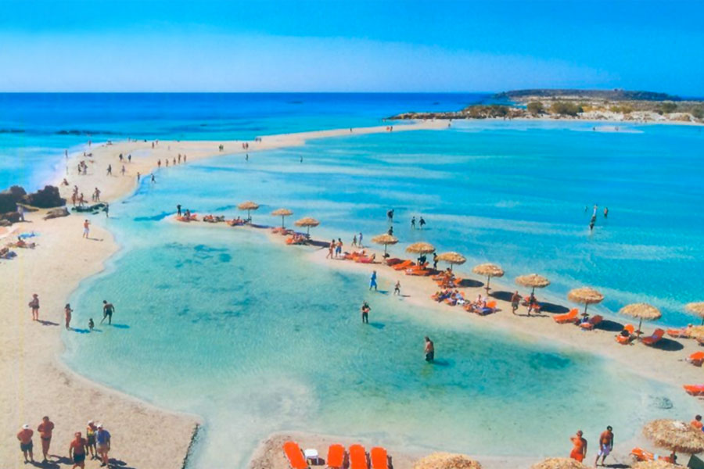
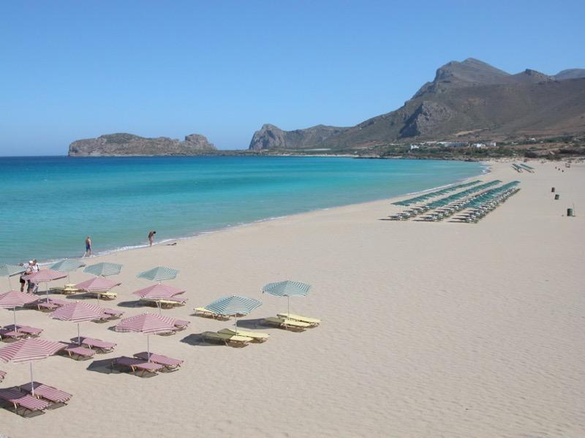
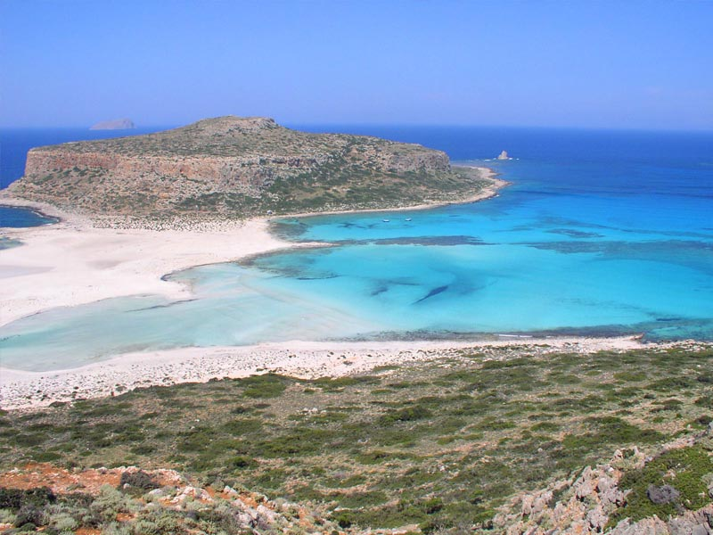
Enjoy the sea and the sun
Elafonisi
It is a small island which you can reach on foot through the hot shallow waters.
Falassarna
A beach that has been declared as one of the most beautiful in the world.
Balos
You can visit Balos by boat and have a nice daily cruise.

Slide 7
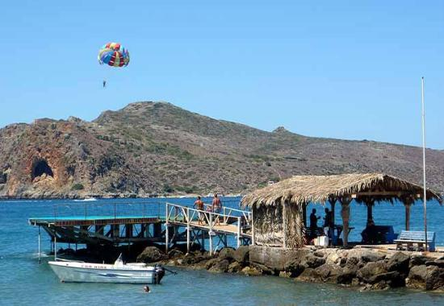
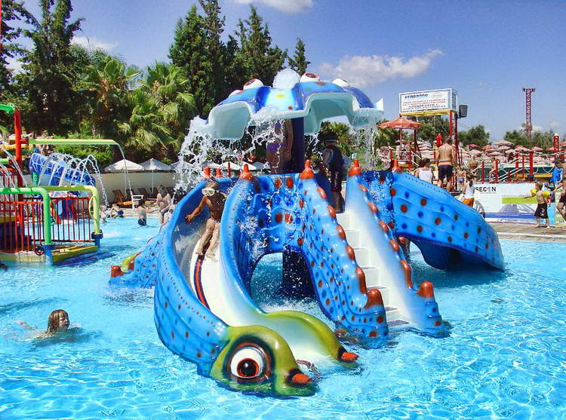
You can have fun doing water sports
Scuba diving, water skiing, jet ski, paraflight or canoe kayak are some of the water sports that can make you have fun in Chania. You can also visit “Limnoupolis” to enjoy the pools and the water slides.

Slide 8
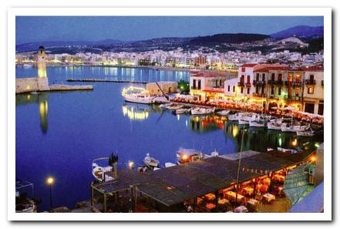
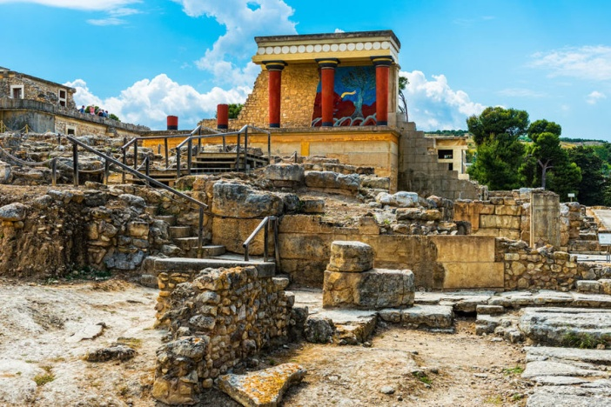
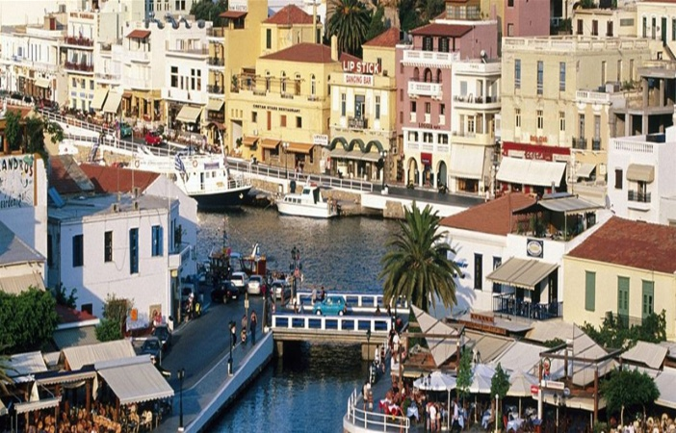
Take a trip to the rest of Crete
RETHYMNO
Close to Chania, it is an ideal destination for vacations too.
HERAKLIO
It's the capital of Crete and it offers a lot to do or see. The most famous sight is the Minoan Palace of Knossos.
LASITHI
Placed in the east side of Crete and it constitutes a romantic place to be.

